Slide 1
Content Analysis – Relationship Extraction
Muhammad Hami Asmai Bin Ismail
Novosibirsk State University

Slide 2
Agenda
What is Relationship Extraction
Underlying Concepts
POS
DEP
Entities
Relation
Common Libraries Relationship Extraction
Visualization

Slide 3
What is Relationship Extraction
Relationship extraction is the task of extracting semantic relationships from a text.
Extracted relationships usually occur between two or more entities of a certain type (e.g. Person, Organisation, Location) and fall into a number of semantic categories (e.g. married to, employed by, lives in).
“Pavel work at a French Company”
Pavel
Work at
A French Company

Slide 4
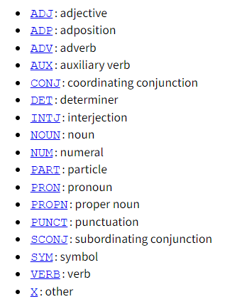
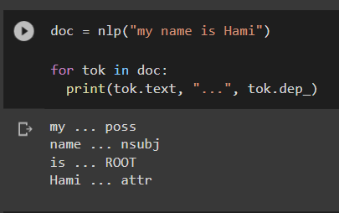
Underlying Concepts
Part of Speech (POS) Tagging
Any English sentence made up of Part of Speech (POS), ie: noun, pronoun, verb, adjective, adverb, preposition, conjunction, and interjection.
A good NLP model, is able to recognize POS for a sentence
Dependency (DEP) Tagging
Dependency is the process to analyze grammatical structure in a sentence. Ie: To understand whether a noun is a “subject” or “object”
https://universaldependencies.org/docs/en/pos/

Slide 5
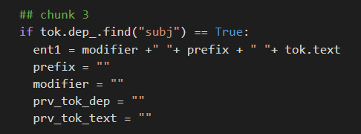
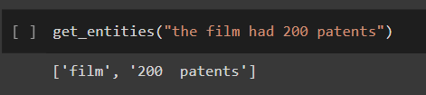
Underlying Concepts
Entities
Based on the dependency parsing of a text, we can get the entities.
For example, a “ROOT” dependency (DEP) is not considered entity because it is simply referring to verb POS.
However, if the dependency (DEP) is “subject”, then it is surely an entity

Slide 6
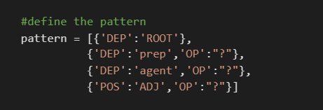
Underlying Concepts
Relation
The relation between 2 entities recognized can be gotten from the pattern of the sentence itself. Typically, verb are used to recognize the relation.

Slide 7
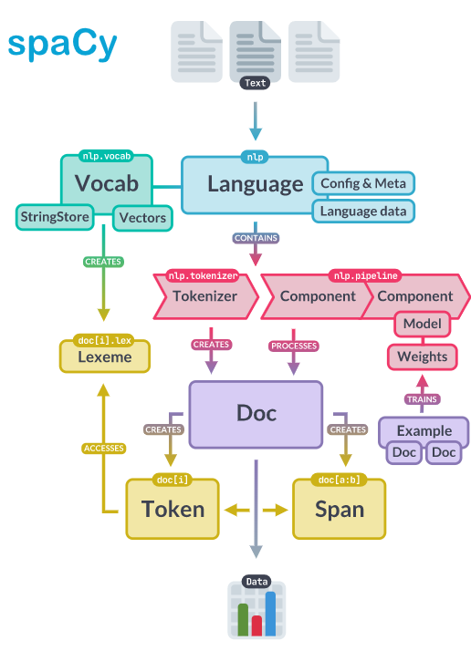
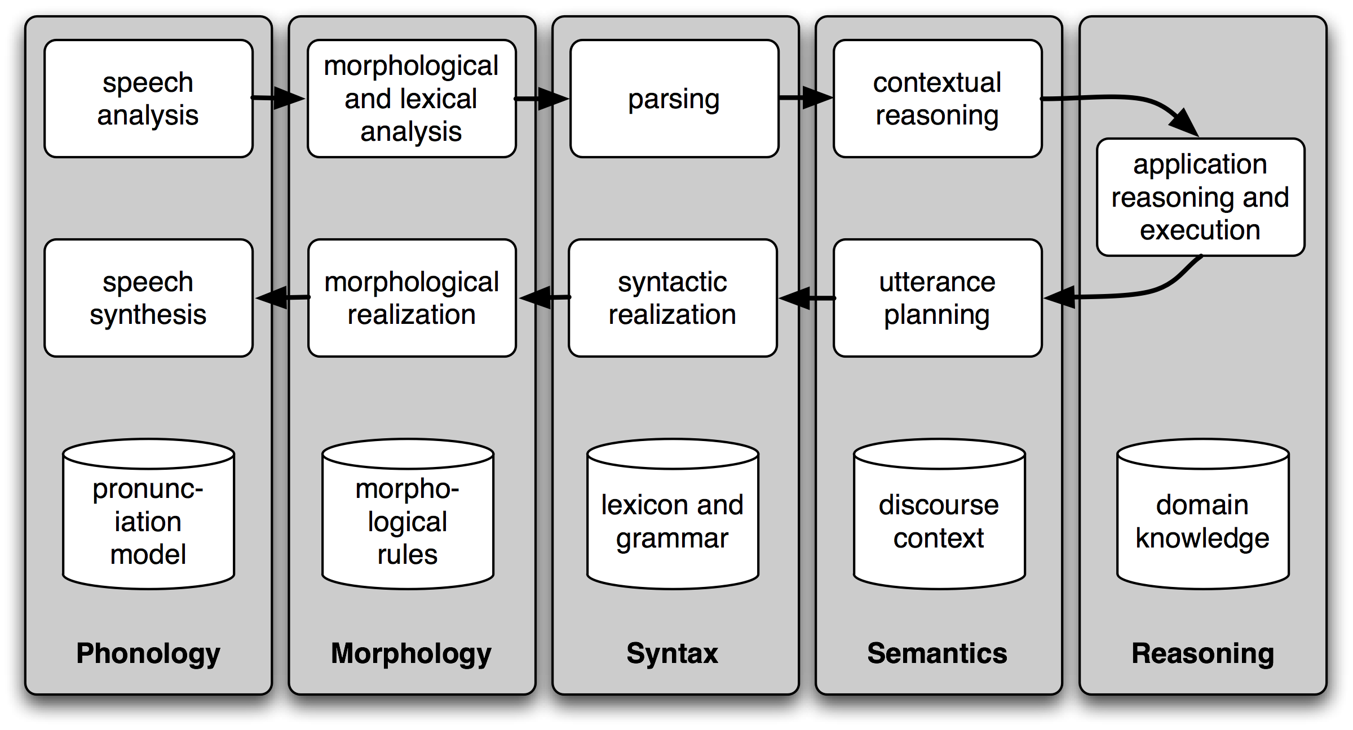
Common Libraries for Relationship Extraction
spaCy
spaCy is a free, open-source library for advanced Natural Language Processing (NLP) in Python.
NLTK
NLTK is a leading platform for building Python programs to work with human language data.
There is an interesting library under NLTK for this task: relextract

Slide 8
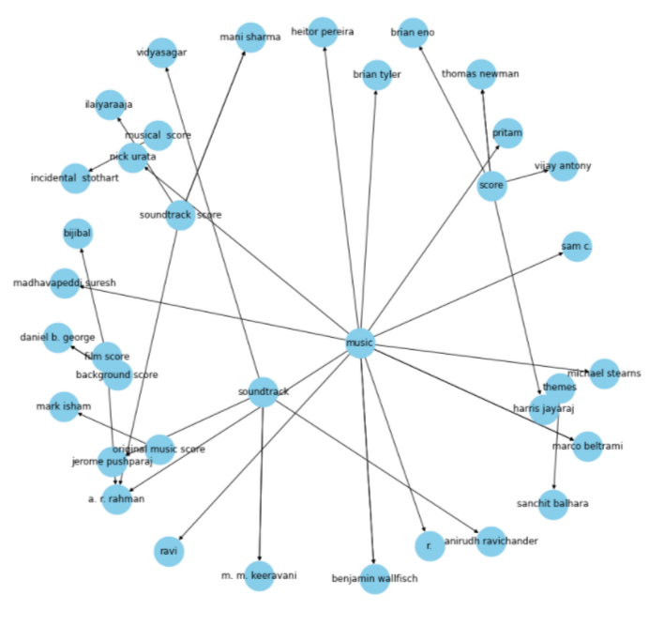
Visualization
Visualization of Relationship is often displayed in “network” graph or graph database.
In Python, Networkx is the common library to be used. They can be created based on Pandas edge table & displayed using Matplotlib

Slide 9
Conclusion
There are various methods for relationship extraction, and dependency & POS identification is one of them.
Relationship extraction can be useful for content analysis and quickly visualize important relations
Further development and research needed to achieve a good model

